Slide 1

Contact Management Software Alpha v0.0.1
By Robert Beatty and Ian Fifer

Slide 2
Customer Requirements
Functionality
CRUD + A
Create
Read
Update
Delete
Archive
Classes
Contact Information
Event
Export ICS File (SEND)
Newsletter
Create and fill in automatic emails

Slide 3
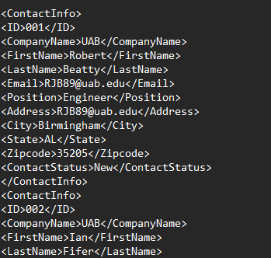
What is it and what does it do?
A Contact Management System For Modern Networking Solutions
Creates And Sends Newsletters
Manage Events With Ease
Works With GUI Interface And Command Line

Slide 4
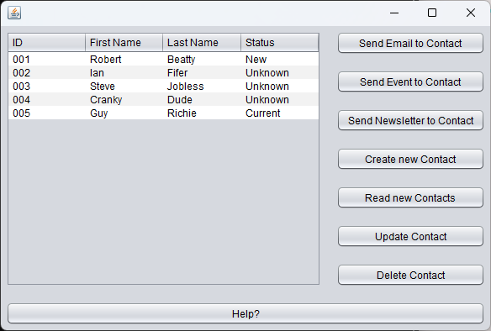
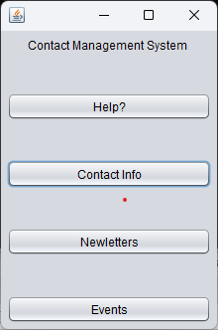
Customer Requirements
VIEW
A control tree was built that allows the user to go from creating Contacts to sending emails to setting up events easily.

Slide 5
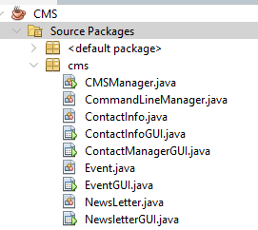
Customer Requirements
MODEL
Three Classes: ContactInfo, Event, NewsLetter
Event and NewsLetter are only valid with a valid ContactInfo, but can be viewed and modified without

Slide 6
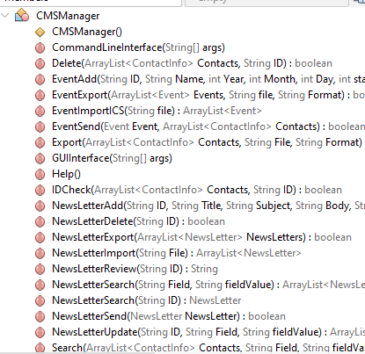
Customer Requirements
Controller
Swaps Between GUI and Command Line
Contains Functions Used By Graphical and Command Interfaces

Slide 7
Challenges and improvements
Challenges
Time Crunch
Data Types for Time
Technical Difficulties
V0.02 Updates
ContactInfo Meeting Date
GUI Interfaces for NewsLetter and Events
Event Update Functionality
Database Functionality
Validation

